Slide 1



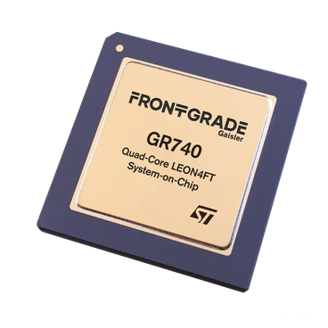

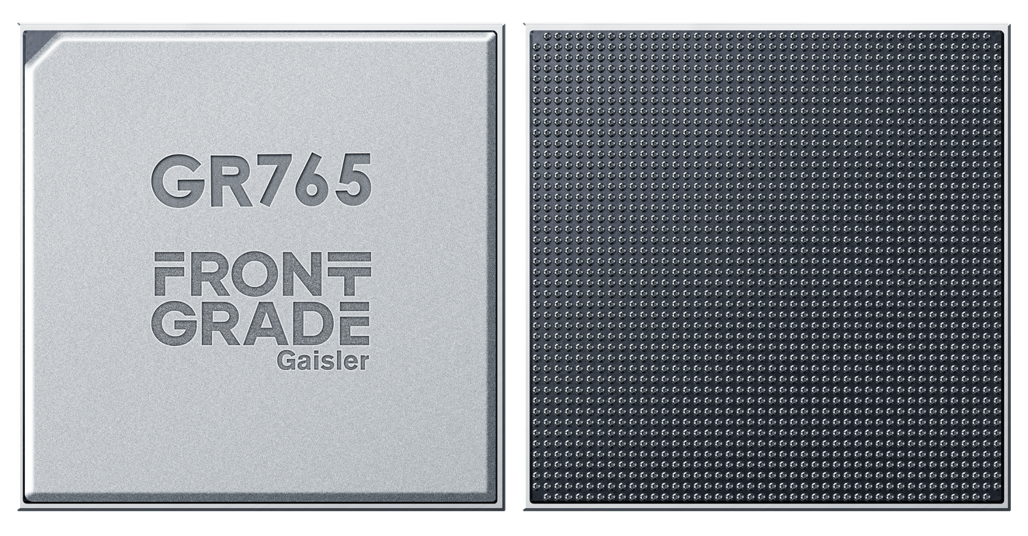
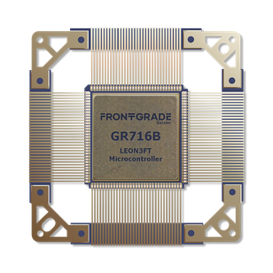
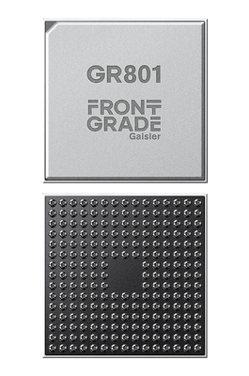








Product Cheat Sheet
GR740
GR765
GR716B
GR801
Proven general purpose space processor
Next generation high performance processor
Radiation
tolerant MCU
Space Al processor
FLIGHT PROVEN
IN DEVELOPMENT
PROTOTYPE/
EARLY AVAILABLILTY
IN DEVELOPMENT
 | OBCs, platform computers, spacecraft control
 | Flight proven multicore platform with strong ecosystem support
 | Quad core LEON4FT SPARC V8
 | "Reliable flight proven processing for a wide range of spacecraft applications."
 | High performance onboard computing, payload data processing
 | Flexible SPARC/RISC-V architecture with high throughput and advanced connectivity
 | 8x LEON5FT SPARC V8 or 8x NOEL-V RISC-V
 | "Next generation high performance space computing with SPARC and RISC-V flexibility."
 | Control systems, mixed signal applications, subsystem control
 | Integrated real time accelerators and mixed signal capabilities
 | LEON3FT SPARC V8
 | Radiation tolerant mixed signal MCU for real time spacecraft control."
 | Al inferencing onboard satellities and payloads
 | Neuromorphic Al processing with low power consumption
 | NOEL-V RISC-V + Akida™ Neuromorphic Al
 | Efficient onboard Al inferencing designed for space applications.
Best for
Best for
Best for
Best for
Key Strenghts
Key Strenghts
Key Strenghts
Key Strenghts
Architecture
Architecture
Architecture
Architecture
Elevator pitch
Elevator pitch
Elevator pitch
Elevator pitch
Quick selection guide
Need proven flight heritage & broad ecosystem
Need maximum performance & next generation features
Need deterministic control & mixed signal functionality
Need Al processing onboard
GR740
GR765
GR716B
GR801

